Slide 1
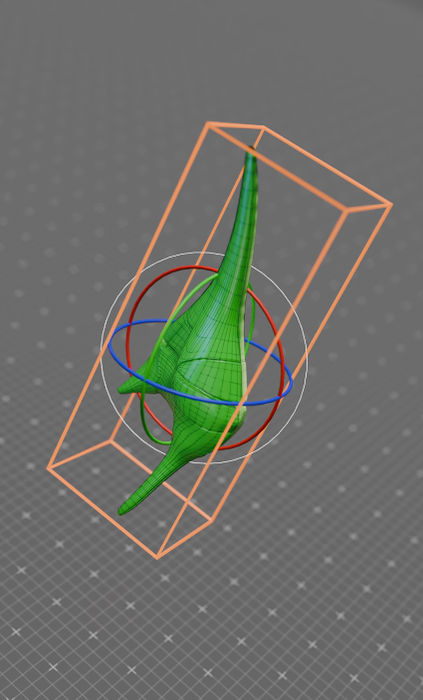
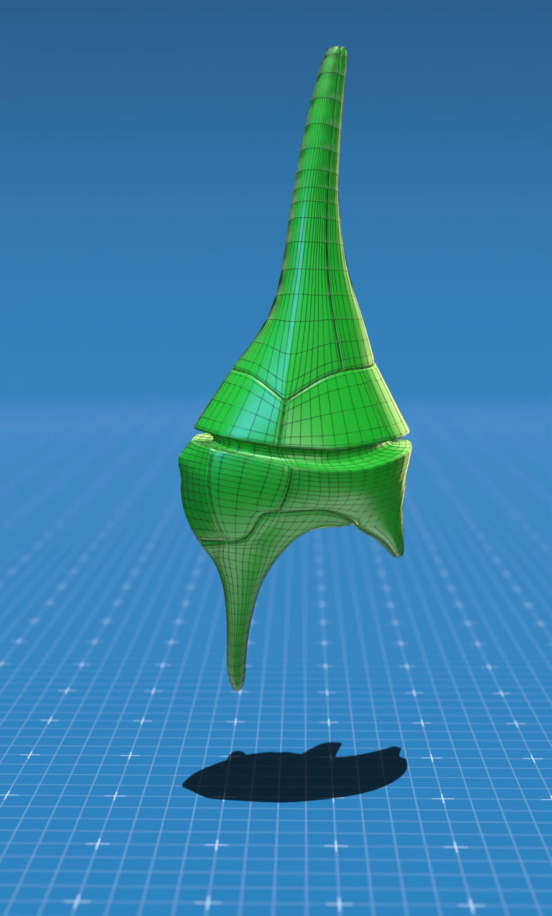
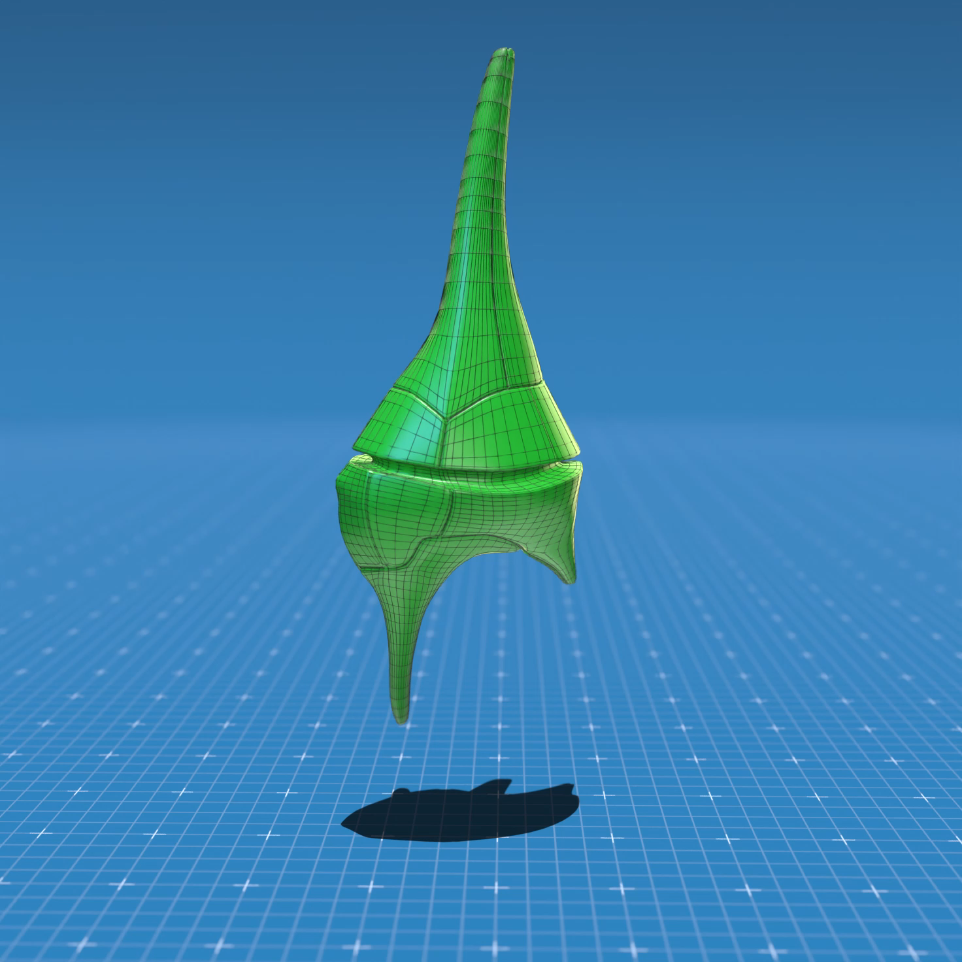

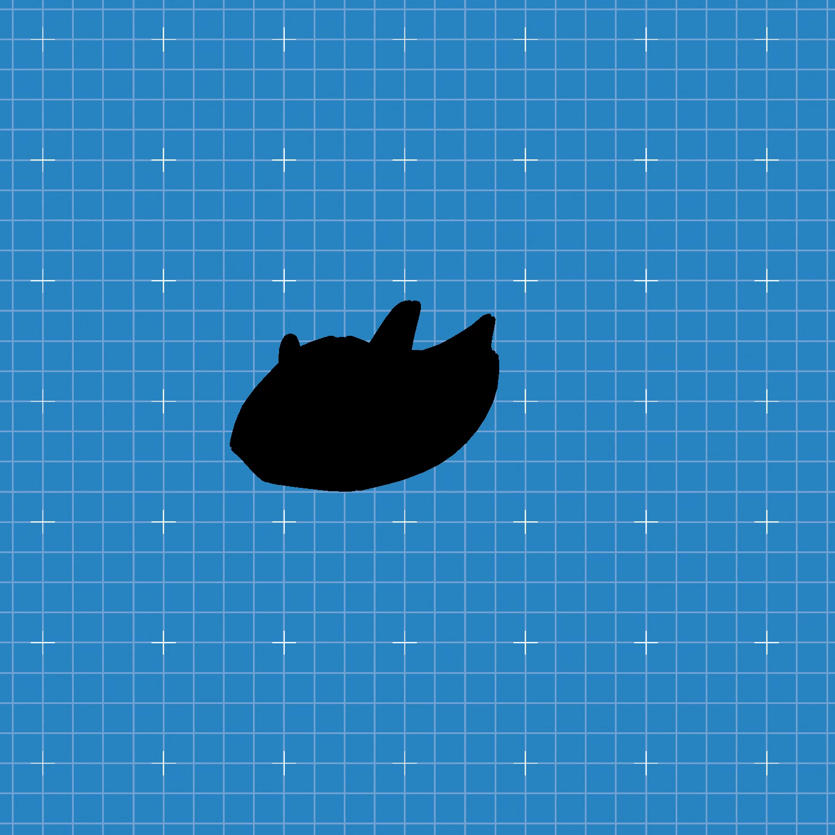
a
b
c
d
e
ESM Figure 1. Rotation of aa shape realistic 3D model of Ceratium furcoides (Levander) Langhans in a virtual space created in Blender environment (a) – schematic object with rotation axis (x,y,z) , (b) rotation on y-axis , (c) tilt on z-axis, (d) rotation and tilt (e ) the shaded projected area.

